Slide 1
CS326 Parallel and Distributed Computing
Fall 2021
National University of Computer and Emerging Sciences

Slide 2
Chapter 3. Principles of Parallel Algorithm Design

Slide 3
A Parallel algorithm is a recipe that tells us how to solve a given problem using multiple processors.
At the very least, concurrency should be there and the algorithm designer must specify sets of steps that can be executed simultaneously.

Slide 4
Constructing a Parallel Algorithm
Identifying portions of the work that can be performed concurrently
Mapping the concurrent pieces of work onto multiple processes running in parallel.
Distributing the input, output, and intermediate data associated with the program.
Managing accesses to data shared by multiple processors.
Synchronizing the processors at various stages of the parallel program execution.
Notes:
Identify ATOMIC block

Slide 5
Decomposition, Tasks, and Dependency Graphs
Decomposition: dividing a computation into smaller parts, some or all of which may potentially be executed in parallel.
Tasks are programmer-defined units of computation .
Tasks can be of arbitrary size, but once defined, they are regarded as indivisible units of computation.
In general, some tasks may use data produced by other tasks and thus may need to wait for these tasks to finish execution.
An abstraction used to express such dependencies among tasks and their relative order of execution is known as a task dependency graph.

Slide 6
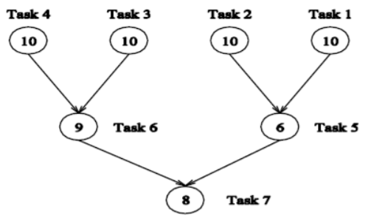
Dependency Graph
Node represent s task.
Directed edge represents control dependence.

Slide 7
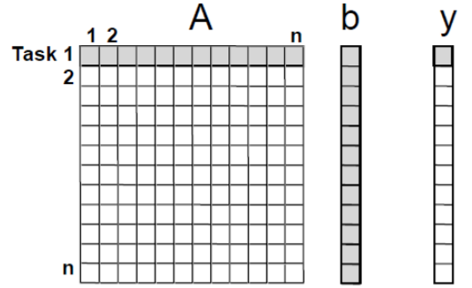
Example 1: Dense Matrix-Vector Multiplication
The computation of each y[i] can be regarded as a task.
All tasks are independent and can be performed all together or in any sequence.

Slide 8
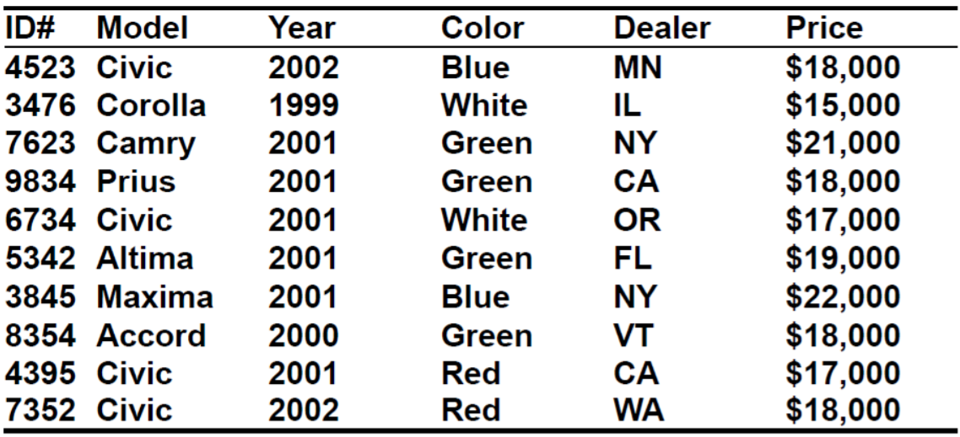
Example 3.2 Database query processing
Executing the query: (on the following database)
Model =“civic” AND Year = “2001” AND (Color = “green” OR Color = “white”)

Slide 9
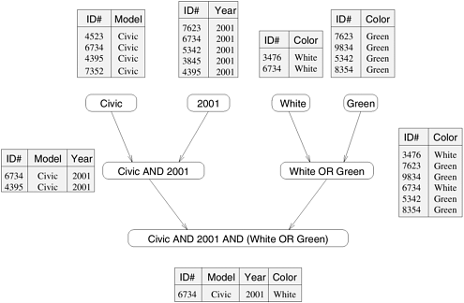
Notes:
this query is processed by creating a number of intermediate tables.
One possible way is to first create the following four tables: a table containing all Civics, a table containing all 2001-model cars, a table containing all green-colored cars, and a table containing all white-colored cars. Next, the computation proceeds by combining these tables by computing their pairwise intersections or unions.

Slide 10
Often there are multiple ways of expressing certain computations, especially those involving associative operators such as addition, multiplication, and logical AND or OR.
Different ways of arranging computations can lead to different task-dependency graphs with different characteristics.

Slide 11
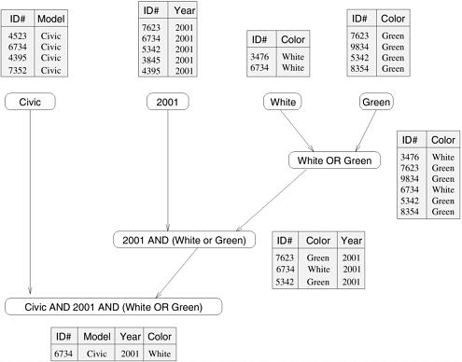
An alternate Data-Dependency Graph

Slide 12
Agglomeration. The task and communication structures defined in the first two stages of a design are evaluated with respect to performance requirements and implementation costs. If necessary, tasks are combined into larger tasks to improve performance or to reduce development costs.
Agglomeration is almost always beneficial if analysis of communication requirements reveals that a set of tasks cannot execute concurrently.

Slide 13
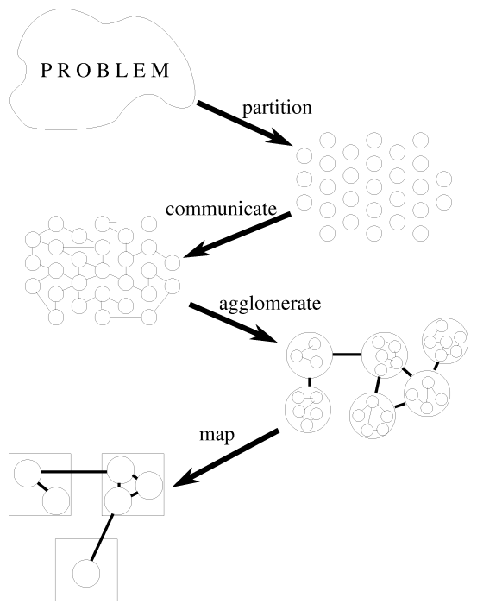
Notes:
Mapping: The mechanism by which tasks are assigned to processes.

Slide 14
Granularity, Concurrency, and Task-Interaction
The number and size of tasks into which a problem is decomposed determines the granularity of the decomposition.
A decomposition into a large number of small tasks is called fine-grained and a decomposition into a small number of large tasks is called coarse-grained.

Slide 15
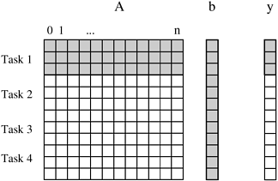
Matrix-vector multiplication example –
coarse-grain: each task computes 3 elements of y[]

Slide 16
Degree of Concurrency: # of tasks that can execute in parallel
maximum degree of concurrency: largest # of concurrent tasks at any point of the execution
average degree of concurrency: average # of tasks that can be executed concurrently
Degree of Concurrency vs. Task Granularity – Inverse relation

Slide 17
Increasing Granularity
A large number of fine-grained tasks does not necessarily produce an efficient parallel algorithm.
Communication costs and task creation costs are overhead that can be reduced by increasing granularity.

Slide 18
Critical path: The longest directed path between any pair of start node (node with no incoming edge) and finish node (node with no outgoing edges).
Critical path length: The sum of weights of nodes along critical path. – The weights of a node is the size or the amount of work associated with the corresponding task
Average degree of concurrency = total amount of work / critical path length

Slide 19
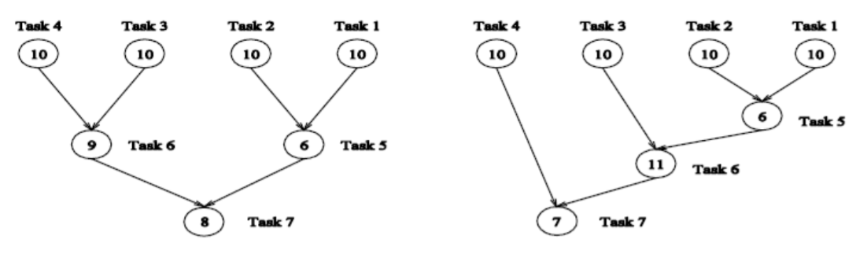
Left graph:
Critical path length = 27
Average degree of concurrency = 63/27 = 2.33
Right graph:
Critical path length = 34
Average degree of concurrency = 64/34 = 1.88
Notes:
Atomic Operations

Slide 20
Task Interaction Graph
Tasks often share input, output, or intermediate data, which may lead to interactions not shown in task-dependency graph.
there may be interactions among tasks that appear to be independent in a task dependency graph
E.g. For the matrix-vector multiplication problem, all tasks are independent, and all need access to the entire input vector b.
The pattern of interaction among tasks is captured by what is known as a task-interaction graph.
The edges in a task interaction graph are usually undirected, but directed edges can be used to indicate the direction of flow of data, if it is unidirectional

Slide 21
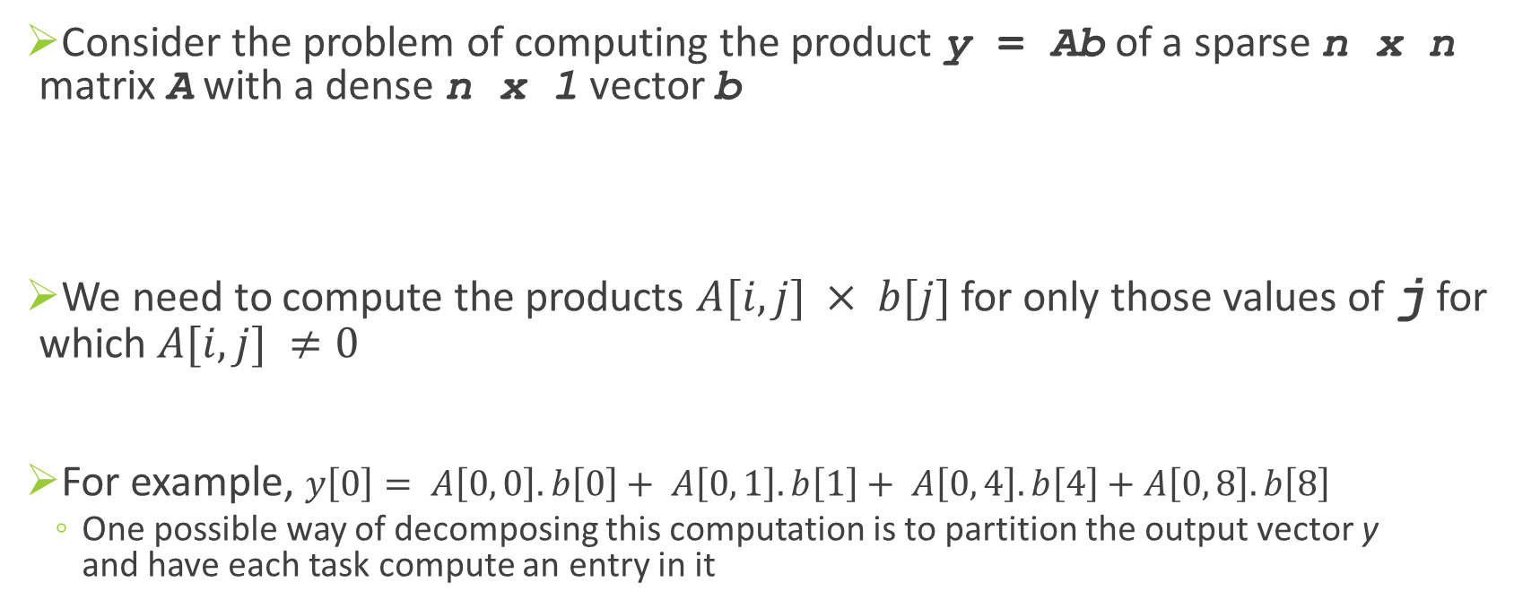
Example 3.3 Sparse matrix-vector multiplication
Consider the problem of computing the product y = Ab of a sparse n x n matrix A with a dense n x 1 vector b
We need to compute the products $A[i, j] × b[j]$ for only those values of j for which $A[i, j] ≠0$
For example, $y\left[0\right]= A\left[0, 0\right].b\left[0\right]+ A\left[0, 1\right].b\left[1\right]+ A\left[0, 4\right].b\left[4\right]+A\left[0, 8\right].b\left[8\right]$
One possible way of decomposing this computation is to partition the output vector y and have each task compute an entry in it
Notes:
A matrix is considered sparse when a significant number of entries in it are zero and the locations of the non-zero entries do not conform to a predefined structure or pattern. Arithmetic operations involving sparse matrices can often be optimized significantly by avoiding computations involving the zeros.

Slide 22
Task i, computes the element y[i] and also also make it the "owner" of row A[i, *] of the matrix and the element b[i] of the input vector.
Note that the computation of y[i] requires access to many elements of b that are owned by other tasks. So Task i must get these elements from the appropriate locations.
In the message-passing paradigm, with the ownership of b[i], Task i also inherits the responsibility of sending b[i] to all the other tasks that need it for their computation.
For example, Task 4 must send b[4] to Tasks 0, 5, 8, and 9 and must get b[0], b[5], b[8], and b[9] to perform its own computation .
Notes:
OWNER COMPUTE rule in Sparse Matrix Multiplication

Slide 23
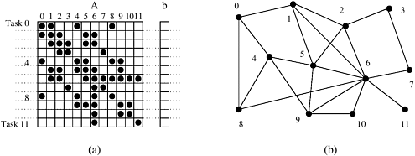

Slide 24
Processes and Mapping
Process: is a program, its local memory, and its communication inports and outports
Mapping. Each task is assigned to a processor in a manner that attempts to satisfy the competing goals of maximizing processor utilization and minimizing communication costs.

Slide 25
Decomposition Techniques
While there is no single recipe that works for all problems, we present a set of commonly used techniques that apply to broad classes of problems
Recursive Decomposition
Data Decomposition
Exploratory Decomposition
Speculative Decomposition

Slide 26
Recursive Decomposition
A method for inducing concurrency in problems that can be solved using the divide-and-conquer strategy.
A problem is solved by first dividing it into a set of independent sub-problems
Notes:
Task: identify a problem which can be solved by recursive decomposition.

Slide 27
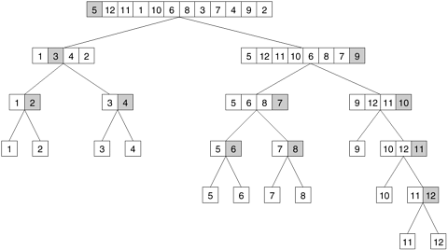
Example: … .
Notes:
Q: How does it support parallel execution?
Q: Does the diagram show task graph?
-concurrency continues to increase as we move down the tree.
-Given a scenario, ask for recursive decomposition of the task.

Slide 28
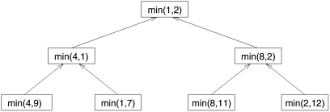
Sometimes, it is possible to restructure a computation to make it amenable to recursive decomposition even if the commonly used algorithm for the problem is not based on the divide-and-conquer strategy. For example:
1.procedure SERIAL_MIN (A, n)
2. begin
3. min = A[0];
4. for i := 1 to n - 1 do
5. if (A[i] < min) min := A[i];
6. endfor;
7. return min;
8. end SERIAL_MIN

Slide 29
A recursive program for finding the minimum in an array of numbers A of length n.
1. procedure RECURSIVE_MIN (A, n) 2. begin 3. if (n = 1) then 4. min := A[0]; 5. else 6. lmin := RECURSIVE_MIN (A, n/2); 7. rmin := RECURSIVE_MIN (&(A[n/2]), n - n/2); 8. if (lmin < rmin) then 9. min := lmin; 10. else 11. min := rmin; 12. endelse; 13. endelse; 14. return min; 15. end RECURSIVE_MIN

Slide 30
Data Decomposition
In this method, the decomposition of computations is done in two steps:
Step I: The data on which the computations are performed is partitioned, and
Step II: this data partitioning is used to induce a partitioning of the computations into tasks.
The operations that these tasks perform on different data partitions are usually similar (e.g., matrix multiplication) or are chosen from a small set of operations.

Slide 31
Partitioning Output Data
In many computations, each element of the output can be computed independently of others as a function of the input.
In such computations, a partitioning of the output data automatically induces a decomposition of the problems into tasks, where each task is assigned the work of computing a portion of the output.

Slide 32

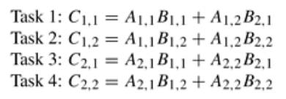
Example: 2 X 2 Matrices Multiplication
Notes:
In such a formulation, the matrix is viewed as composed of blocks or sub-matrices and the scalar arithmetic operations on its elements are replaced by the equivalent matrix operations on the blocks

Slide 33
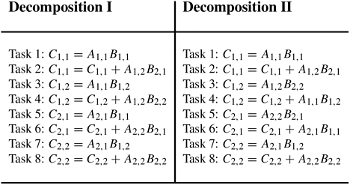
Two examples of decomposition of matrix multiplication into eight tasks.

Slide 34
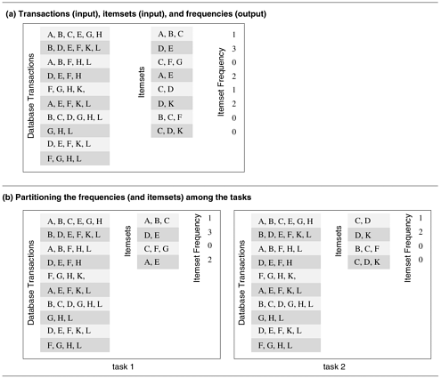
Example: Computing frequencies of itemsets in a Transaction Database
Notes:
Figure (b) shows how the computation of frequencies of the itemsets can be decomposed into two tasks by partitioning the output into two parts and having each task compute its half of the frequencies. Note that, in the process, the itemsets input has also been partitioned, but the primary motivation for the decomposition of Figure 3.12(b) is to have each task independently compute the subset of frequencies assigned to it.

Slide 35
Partitioning Input Data
Partitioning of output data can be performed only if each output can be naturally computed as a function of the input.
In many algorithms, it is not possible or desirable to partition the output data. For example, while finding the minimum, maximum, or the sum of a set of numbers, the output is a single unknown value.
In such cases, it is sometimes possible to partition the input data, and then use this partitioning to induce concurrency.

Slide 36
A task is created for each partition of the input data and this task performs as much computation as possible using these local data.
The solutions to tasks induced by input partitions may not directly solve the original problem. In such cases, a follow-up computation is needed to combine the results.
The problem of computing the frequency of a set of itemsets in a transaction database described in previous example can also be decomposed based on a partitioning of input data:

Slide 37
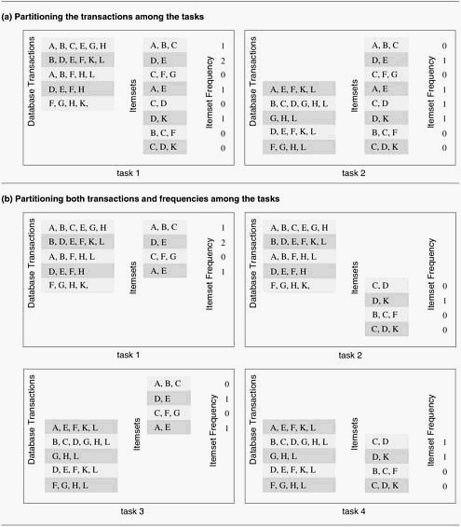

Slide 38
Partitioning both Input and Output Data

Slide 39
Partitioning Intermediate Data
Algorithms are often structured as multi-stage computations such that the output of one stage is the input to the subsequent stage.
Such an algorithm may be decomposed by partitioning the input or the output data of an intermediate stage of the algorithm.
Often, the intermediate data are not generated explicitly in the serial algorithm for solving the problem and some restructuring of the original algorithm may be required to use intermediate data partitioning.

Slide 40
Exploratory Decomposition
Exploratory decomposition is used to decompose problems whose underlying computations correspond to a search of a space for solutions.
In exploratory decomposition, we partition the search space into smaller parts, and search each one of these parts concurrently, until the desired solutions are found.
Notes:
In which successive configurations or states of an instance are considered, with the intention of finding a goal state with a desired property.

Slide 41
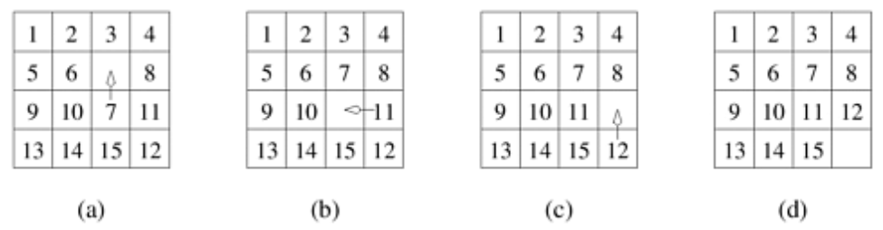
Example: the 15-Puzzle Problem
Notes:
The 15-puzzle is typically solved using tree-search techniques. Starting from the initial configuration, all possible successor configurations are generated. A configuration may have 2, 3, or 4 possible successor configurations, each corresponding to the occupation of the empty slot by one of its neighbors.

Slide 42
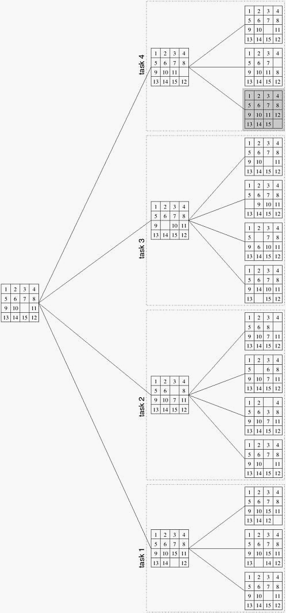
Parallel Execution
Notes:
As soon as one of the concurrent tasks finds a solution it can inform the others to terminate their searches.

Slide 43
Data Decomposition Vs Exploratory Decomposition
The tasks induced by data-decomposition are performed in their entirety and each task performs useful computations towards the solution of the problem.
On the other hand, in exploratory decomposition, unfinished tasks can be terminated as soon as an overall solution is found

Slide 44
The portion of the search space searched (and the aggregate amount of work performed) by a parallel formulation can be very different from that searched by a serial algorithm.
The work performed by the parallel formulation can be either smaller or greater than that performed by the serial algorithm.
Consider the different positions of solution.

Slide 45
Speculative Decomposition
Speculative decomposition is used when a program may take one of many possible computationally significant branches depending on the output of other computations that precede it.
Scenario is similar to evaluating one or more of the branches of a switch statement in C in parallel before the input for the switch is available.
While one task is performing the computation that will eventually resolve the switch, other tasks could pick up the multiple branches of the switch in parallel.
When the input for the switch has finally been computed, the computation corresponding to the correct branch would be used while that corresponding to the other branches would be discarded.

Slide 46
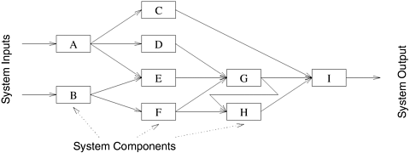
Example 3.8 Parallel discrete event simulation

Slide 47
Activity
Find the minimum of an array of size 16 using four tasks.

Slide 48
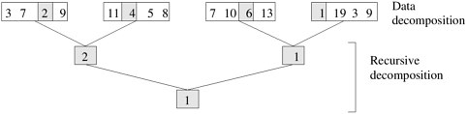
Hybrid Decompositions
Example: finding the minimum of an array of size 16 using four tasks.

Slide 49
PRACTICE TASK: Propose a Parallel Solution to the following

Slide 50
